Slide 1
Presentation on project
WEDDING PLANNER
Presented By :-Vijaykumar Mane
Regno:- CA182006 Guide:- Shri. T.R. Arunkumar

Slide 2
iNDEX
Introduction
System Requirement Specification
Modules
Implementation

Slide 3
Introduction
Wedding is once in a life time affair and everyone wants theirs or their children’s wedding to be a memorable one. To help you organize wedding in the most organized and well arranged manner given here are some tips from wedding experts, neatly organized by subjects. An effort has also been made in this section to provide understanding of deeper meaning behind the various rituals and cultural aspects of Indian wedding. Weddings are a relatively simple but joyful affair.

Slide 4
System Requirement Specification
Software Requirement -
Operating system : Windows 10 or more
Programming Language : PHP
Front End : Html, Css, Javascript
Back End : MySQL

Slide 5
Hardware Requirement
Processor : Intel core i3
Ram : 4 GB
Hard Disk : 10 GB

Slide 6
Modules
Administrator.
Customer/Client.
Service Providers/Vendors.

Slide 7
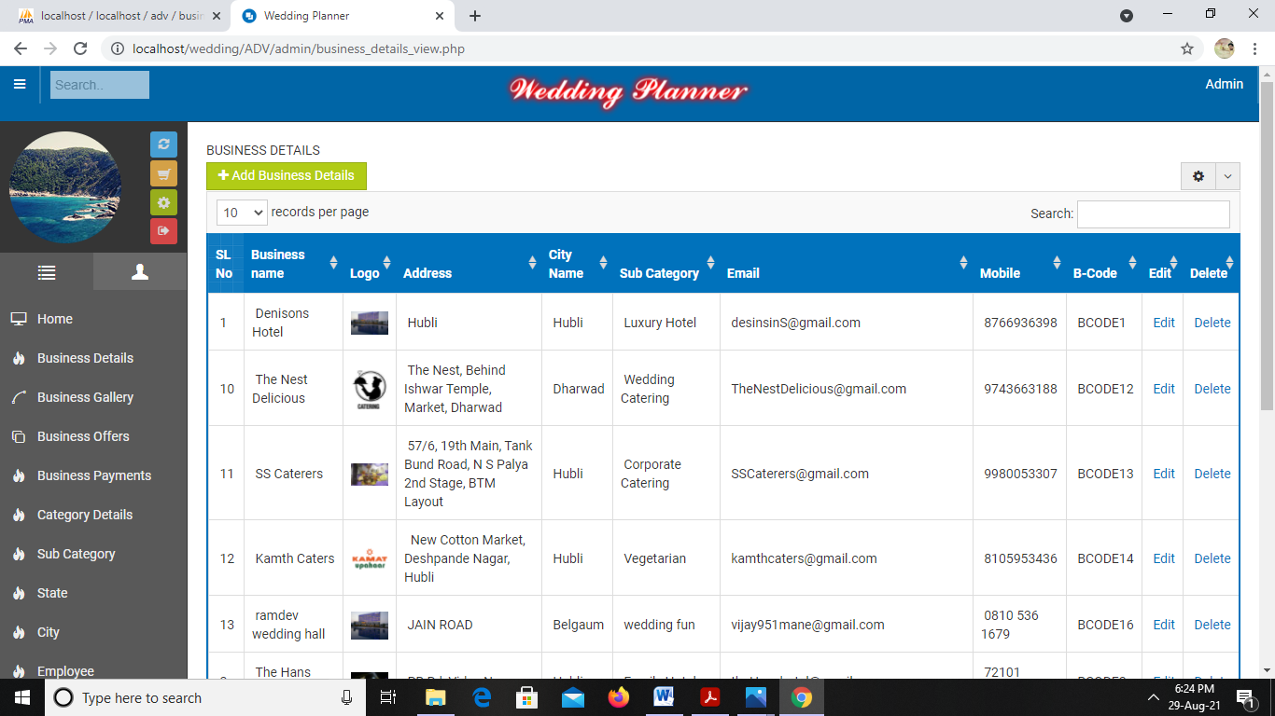
implementation
1. Business details:
Fig:1. business details

Slide 8
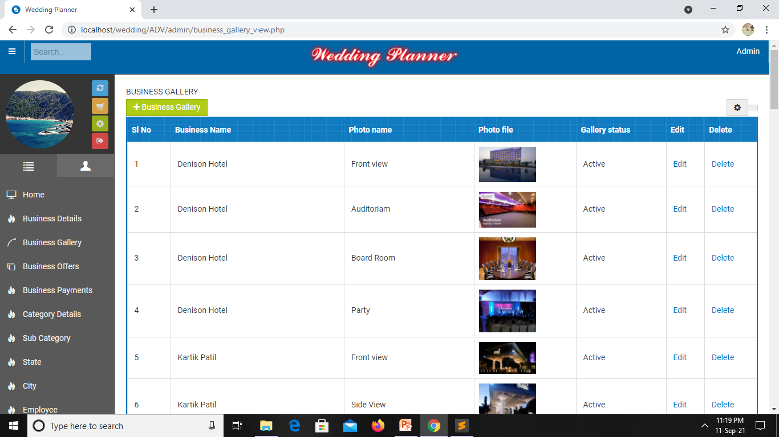
2. Business Gallery:
Fig:2.business gallery

Slide 9
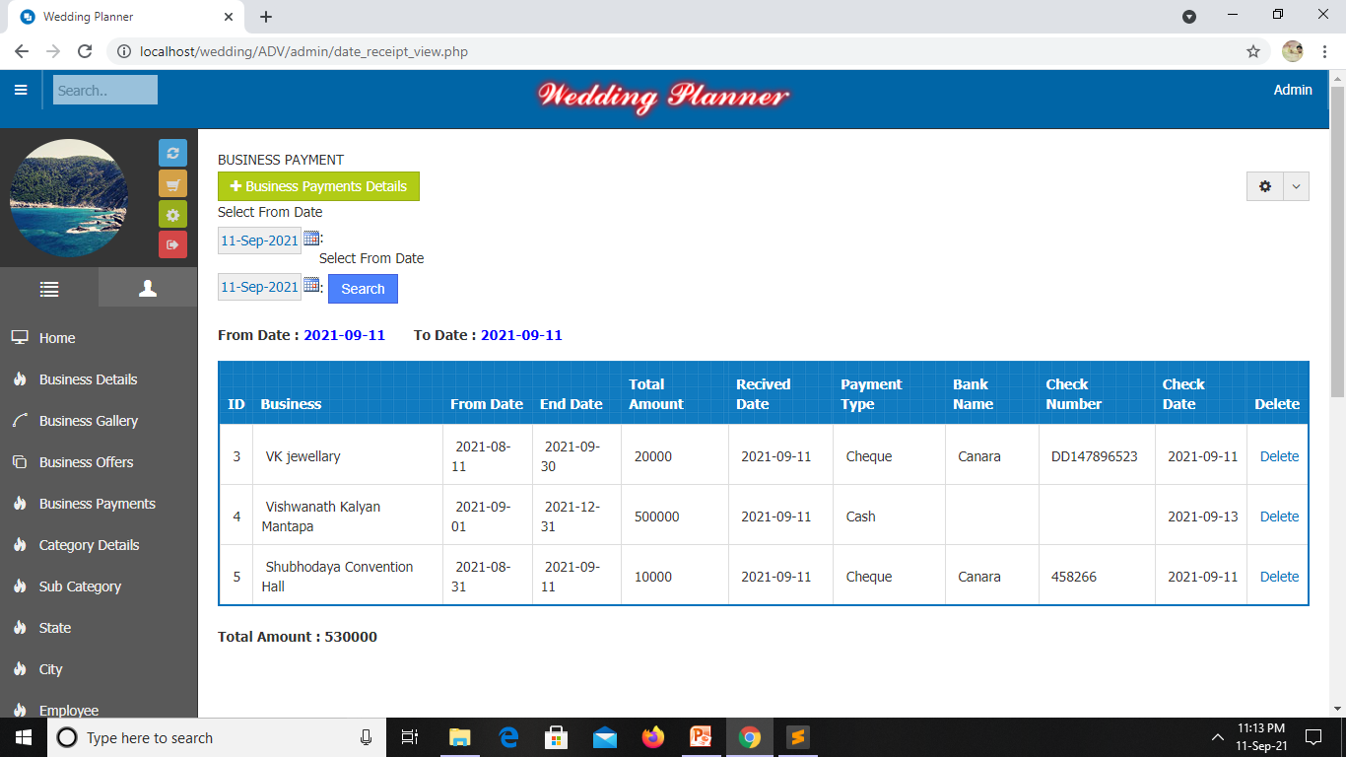
3. Business Payment:
Fig: 3.business payment

Slide 10
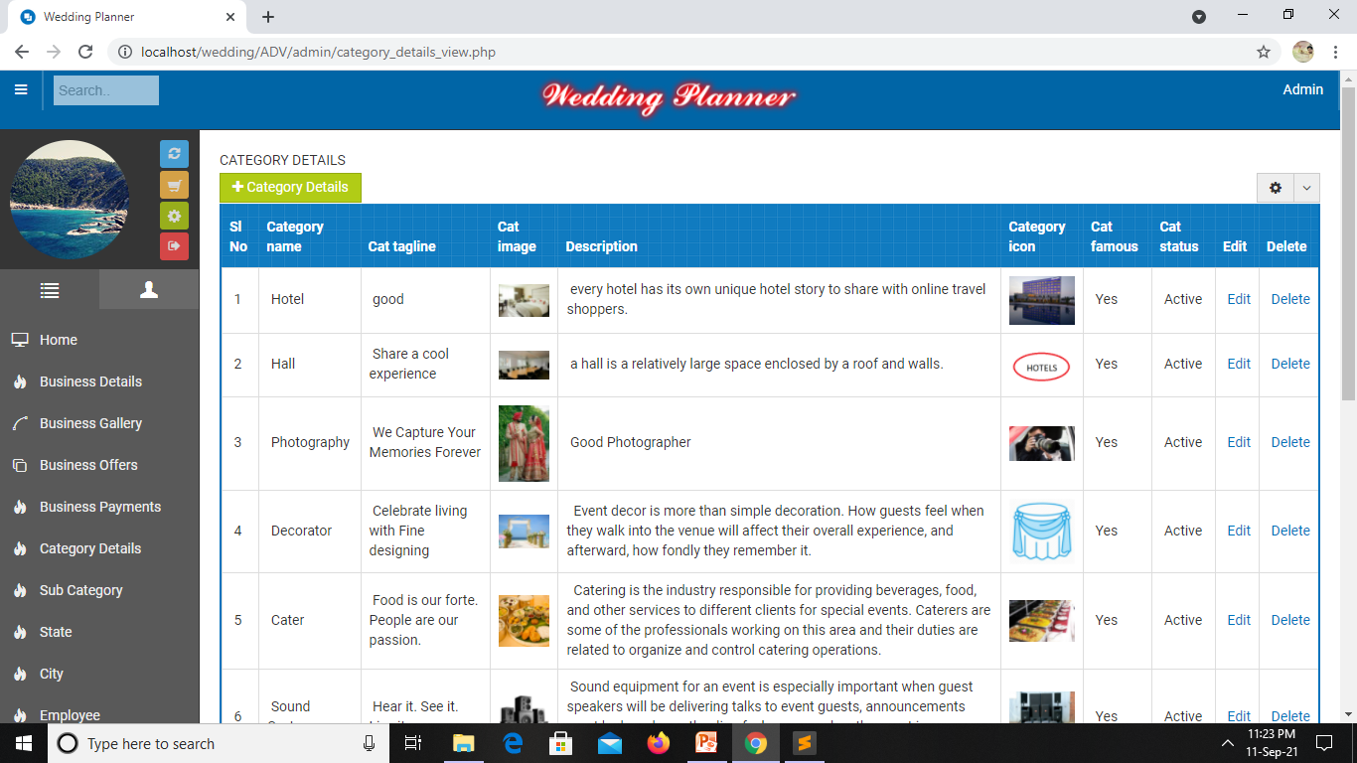
4. Category Details:
Fig: 4. category details

Slide 11
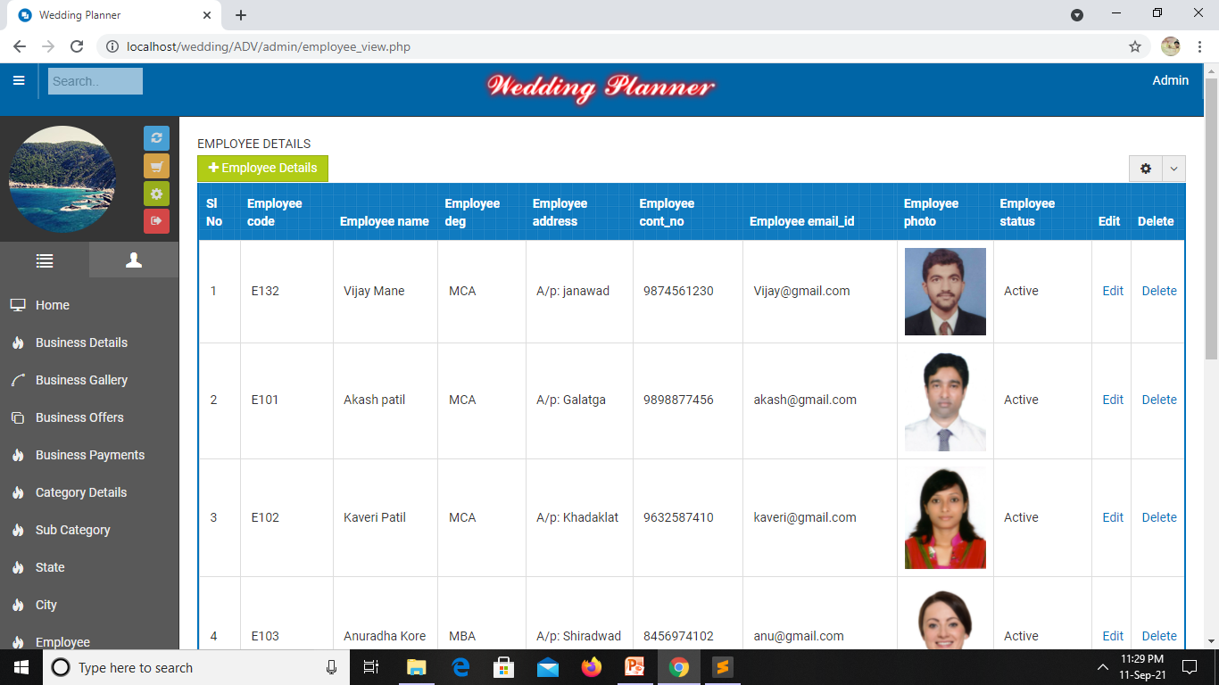
5. Employee Details:
Fig:5. employee details

Slide 12
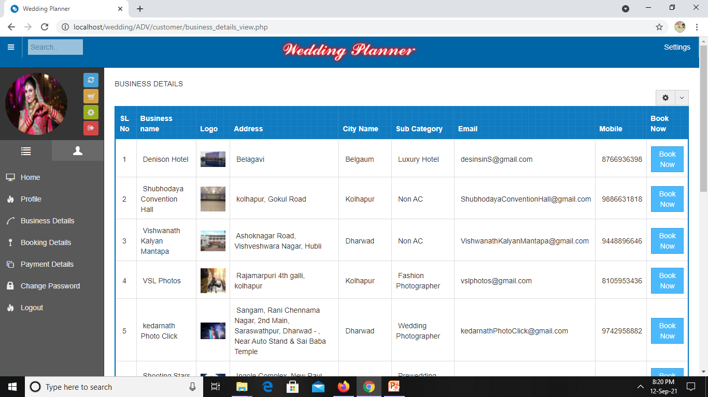
6. Customer Business Details
Fig:6. Customer Business Details

Slide 13
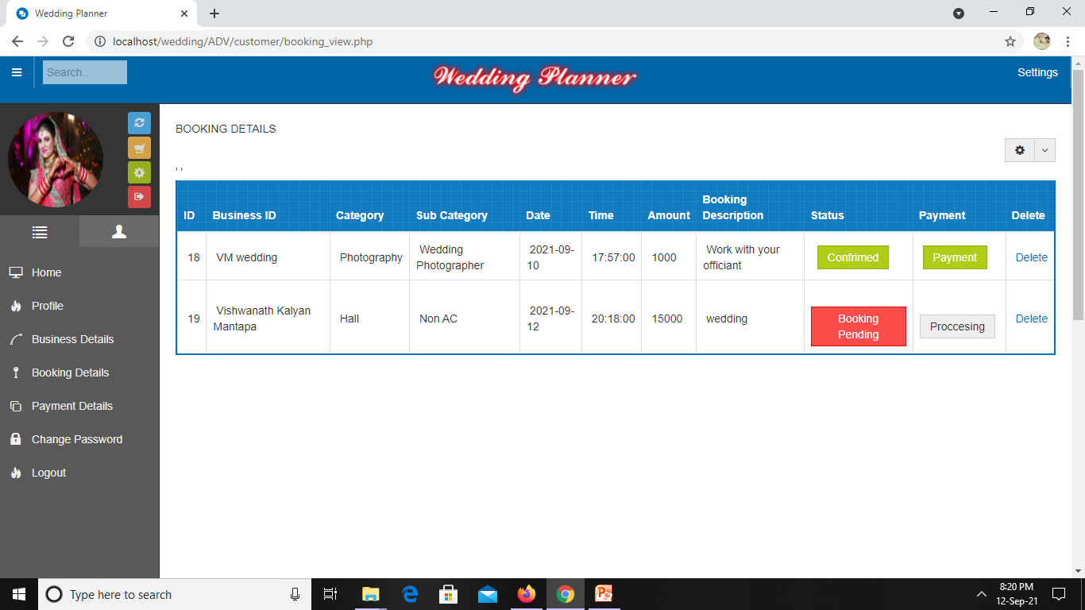
7. Customer Booking Details
Fig:7. Customer Booking Details

Slide 14
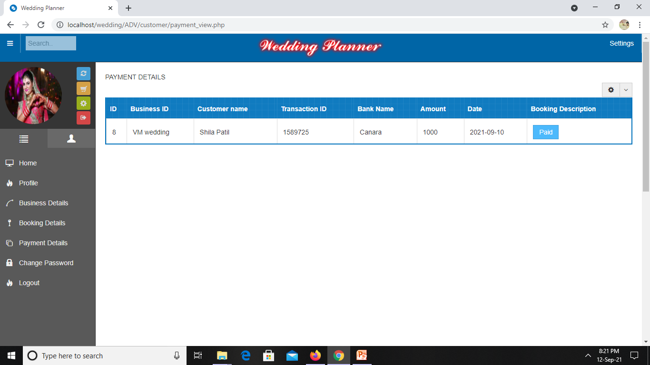
8. Customer Payment Details
Fig:8. Customer Payment Details

Slide 15
Thank you

